Slide 1
Task 2 Ethical Hacking
Scanning vulnerabilities of http://webappsecurity.com/

Slide 2
Unfortunately Netsparker could not be used for the scanning as the file contained some virus/malware and nikto was used for scanning the given website

Slide 3
REPORT
Vulnerability 1:Out -of -date Version(jQuery)
Domain:http://webappsecrity.com/
The vulnerability is a critical one
It states that the website is using jQuery and is out of date
Impacts:An out of date version can have vulnerabilities and will lack security features which will make it prone to attacks
Mitigation:Update to the latest version

Slide 4
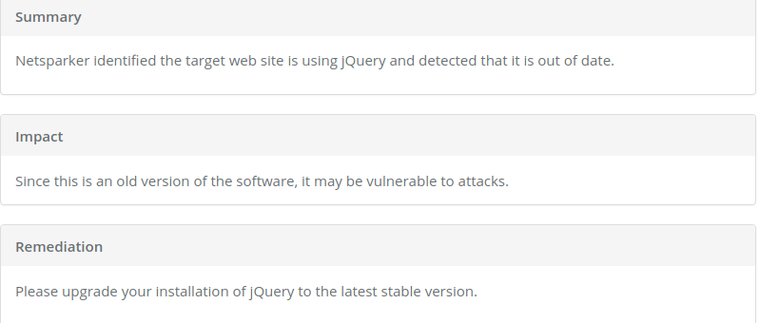

Slide 5
REPORT
Vulnerability 2:XSS -Cross Site Scripting
Domain:http://webappsecurity.com/
Cross-Site Scripting (XSS) attacks are a type of injection, in which malicious scripts are injected into otherwise benign and trusted websites. XSS attacks occur when an attacker uses a web application to send malicious code, generally in the form of a browser side script, to a different end user. Flaws that allow these attacks to succeed are quite widespread and occur anywhere a web application uses input from a user within the output it generates without validating or encoding it.

Slide 6
Causes for XSS
Data enters a Web application through an untrusted source, most frequently a web request.
The data is included in dynamic content that is sent to a web user without being validated for malicious content.
Impact
Cross site scripting attacks can have devastating consequences. Code injected into a vulnerable application can exfiltrate data or install malware on the user’s machine. Attackers can masquerade as authorized users via session cookies, allowing them to perform any action allowed by the user account.
XSS can also impact a business’s reputation. An attacker can deface a corporate website by altering its content, thereby damaging the company’s image or spreading misinformation. A hacker can also change the instructions given to users who visit the target website, misdirecting their behavior. This scenario is particularly dangerous if the target is a government website or provides vital resources in times of crisis.

Slide 7
Mitigation
1.Train and maintain awareness
2.Don’t trust any user input
3.Use escaping/encoding
4.Sanitize HTML
5.Set the HttpOnly flag
6.Use a content security policy
7.Scan regularly

Slide 8
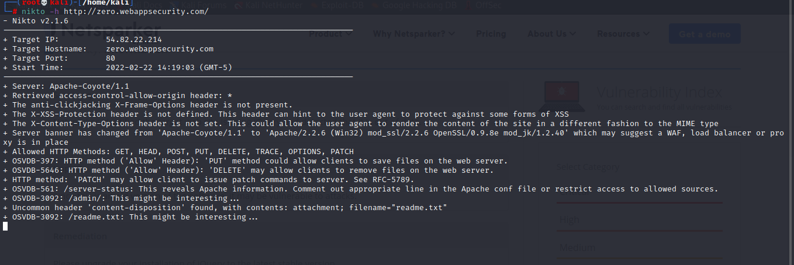
Screenshot of nikto scanner

